Slide 1
Malignant Comments Classifier Project
Submitted By:
SYED MUGERA BILAL
syedbilalarmaan@gmail.com

Slide 2
Contents
About the project
Data source & their formats
Hardware, Software and Tools
Data Analysis
Data Cleaning
Exploratory Data Analysis (EDA)
Splitting the data
Building Machine Learning Algorithms
Evaluation of ML Models
Result of ML Models
Conclusion

Slide 3
About the project
People use social media as a platform to express their opinions and views.
However, at the same time, this has resulted in the emergence of conflict and hate, making online environments uninviting for users.
Online hate, described as abusive language, aggression, cyberbullying, hatefulness and many others has been identified as a major threat on online social media platforms.
Our goal is to build a prototype of online hate and abuse comment classifier which can used to classify hate and offensive comments so that it can be controlled and restricted from spreading hatred and cyberbullying.

Slide 4
MULTI-LABEL VS MULTI CLASS CLASSIFICATION
In multi-class classification, the data can belong to only one label out of all the labels we have. For example, a given picture of an animal may be a cat, dog or elephant only and not a combination of these.
In multi-label classification, data can belong to more than one label simultaneously. For example, in our case a comment may be malignant, threat or loathe at the same time. It may also happen that the comment is positive/neutral and hence does not belong to any of the six labels.
The goal of the multi-label classification is to determine whether or not a comment is toxic or non-toxic. If toxic, to determine what kind of toxicity the comment is, like-in, malignant, highly-malignant, threat, rude, abuse or loathe. Thus, a model needs to be created in order to differentiate between comments and its categories.

Slide 5
Data source and their format
The data set contains the training set, which has approximately 1,59,000 samples and the test set which contains nearly 1,53,000 samples. All the data samples contain 8 fields which includes ‘Id’, ‘Comments’, ‘Malignant’, ‘Highly malignant’, ‘Rude’, ‘Threat’, ‘Abuse’ and ‘Loathe’.
The label can be either 0 or 1, where 0 denotes a NO while 1 denotes a YES. There are various comments which have multiple labels. The first attribute is a unique ID associated with each comment.
The data set includes:
- Malignant: It is the Label column, which includes values 0 and 1, denoting if the comment is malignant or not.
- Highly Malignant: It denotes comments that are highly malignant and hurtful.
- Rude: It denotes comments that are very rude and offensive.
Threat: It contains indication of the comments that are giving any threat to someone.

Slide 6
- Abuse: It is for comments that are abusive in nature.
- Loathe: It describes the comments which are hateful and loathing in nature.
- ID: It includes unique Ids associated with each comment text given.
- Comment text: This column contains the comments extracted from various social media platforms.

Slide 7
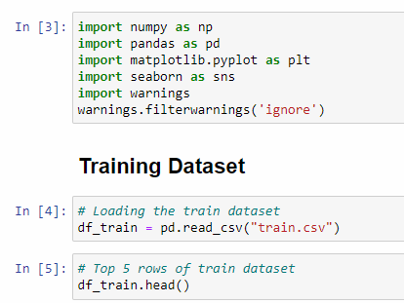
Hardware, Software and Tools
For doing this project, we require laptop with high configuration and specification with a stable Internet connection.
Microsoft office, Anaconda distribution as software.
Python 3.x as programming language.
Jupyter Notebook as Editor which is in Anaconda navigator.
Some tools or libraries required like Numpy – used to numerical calculations. Pandas – used to data manipulation. Matplotlib and Seaborn – used to data visualization.

Slide 8


Data Analysis
The train dataset has 159571 rows and 8 columns.
The test dataset has 154164 rows and 2 columns.

Slide 9
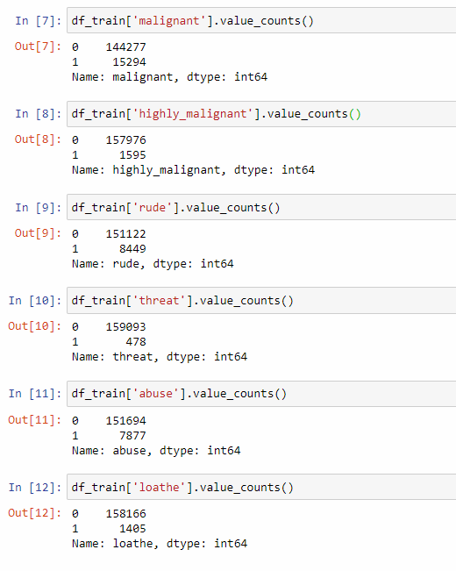
Data Pre-processing
Checking the value counts of the features

Slide 10
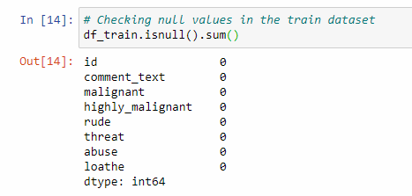
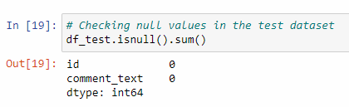
Checking for null values

Slide 11
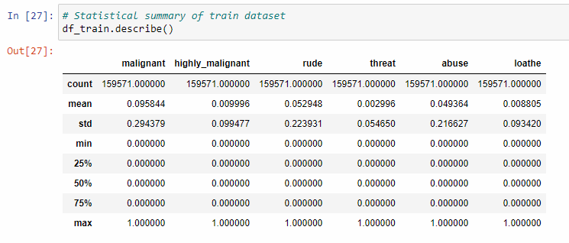
Checking statistical summary of the dataset
The minimum value and the maximum value of the attributes is same i.e., 0 and 1 respectively.
The mean and standard deviation is nearly 0-1 of all the attributes in the training dataset.
Here, with this statistical analysis, it is interpreted that there are no outliers as well as skewness present in this training dataset.
The count of each field is equal which shows that there are no missing values present.

Slide 12
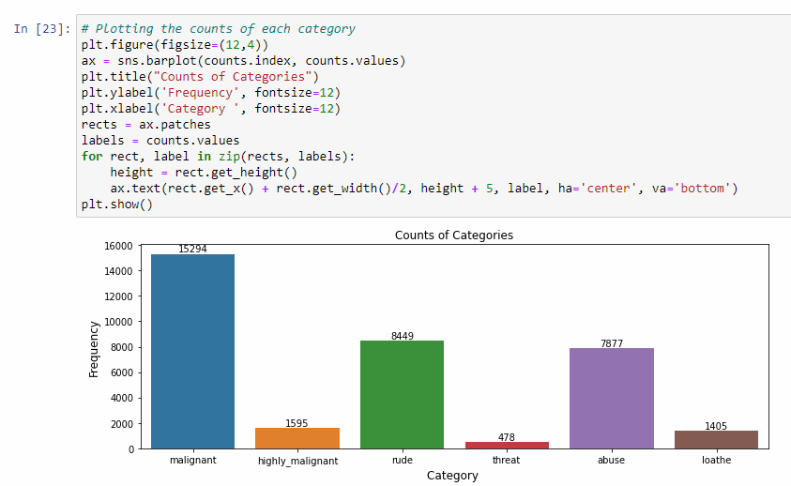
Exploratory Data Analysis (EDA)
Malignant comments are the highest among all whereas threat comments are very less. Rude and abuse comments are also present more.

Slide 13
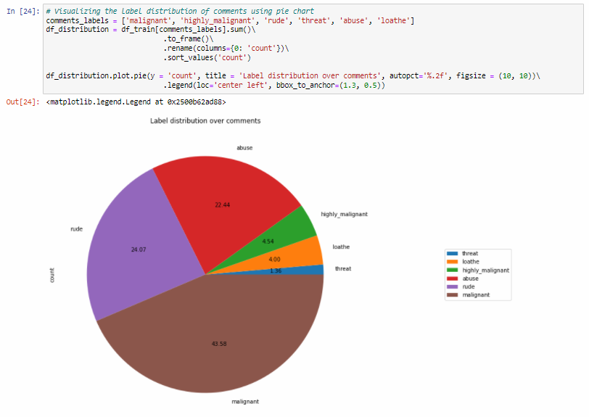
Plotting pie-chart

Slide 14
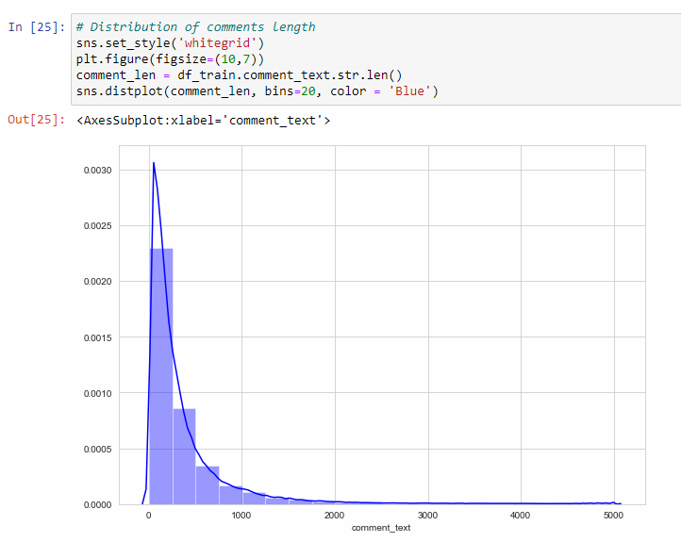
Above is a plot showing the comment length frequency. As noticed, most of the comments are short with only a few comments longer than 1000 words. Majority of the comments are of length 500, where maximum length is 5000 and minimum length is 5. Median length being 250.

Slide 15
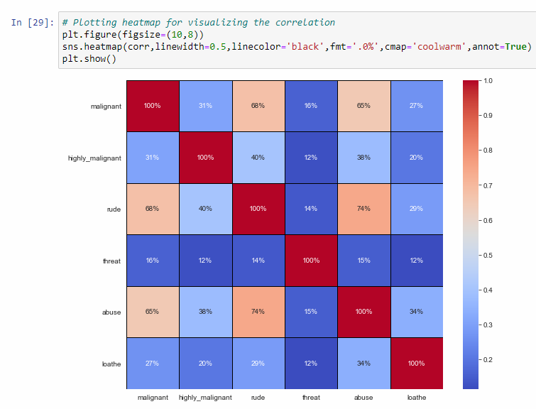
The highest positive correlation is seen in between fields 'rude' and 'abuse'.
Attribute 'threat' is negatively correlated with each and every other feature of this training dataset.
Overall the correlation among the attributes is not positive.

Slide 16
Dropping the Column
Due to the wide range of given data, it is extremely fruitful to clean, shape and set the data in the most suitable form. Dropping unnecessary columns declines the chances of producing errors. Thus, column ‘ID’ was dropped from the train dataset as every comment has its own unique id. After dropping the same, the dataset is now having 7 attributes in total including the target variables.
Cleaning the data using NLP
● Replaced the extra lines or ‘\n’ from the text.
● Transform the text into lower case.
● Replaced the email addresses with the text 'emailaddress'
● Replaced the URLs with the text 'webaddress'
● Removed the numbers
● Removed the HTML tags
● Removed the punctuations
● Removed all the non-ascii characters
● Removed the unwanted white spaces
● Removed the remaining tokens that are not alphabetic
● Removed the stop words

Slide 17
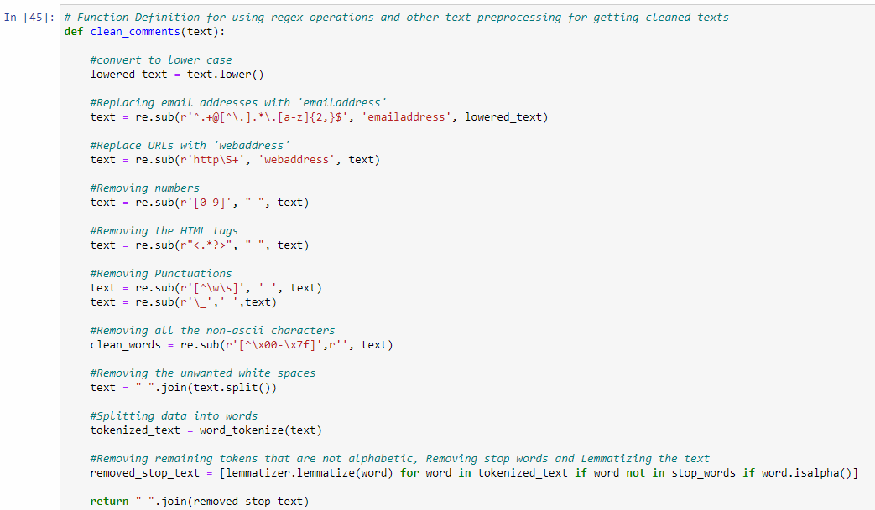

Slide 18
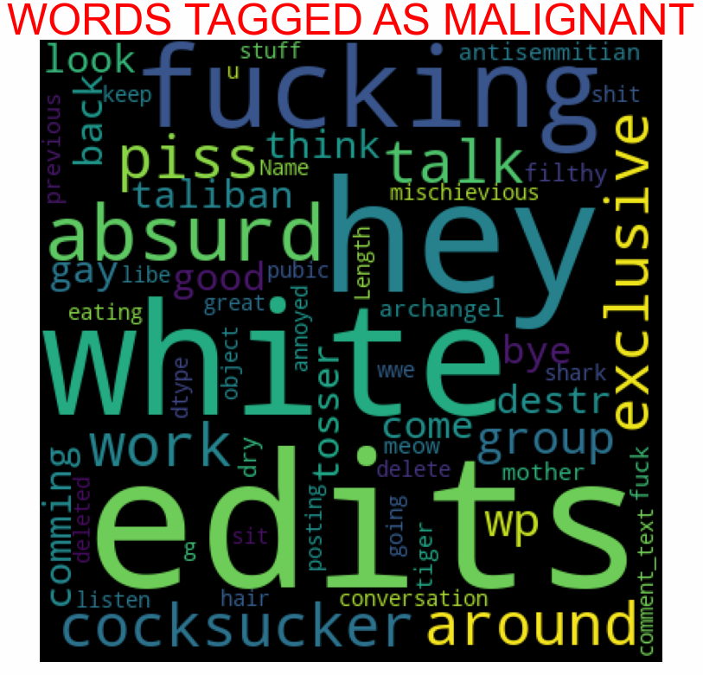
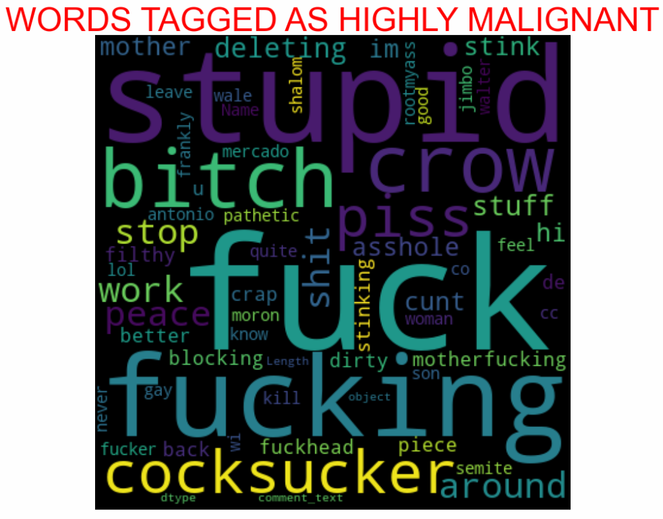
Plotting wordcloud for each feature

Slide 19
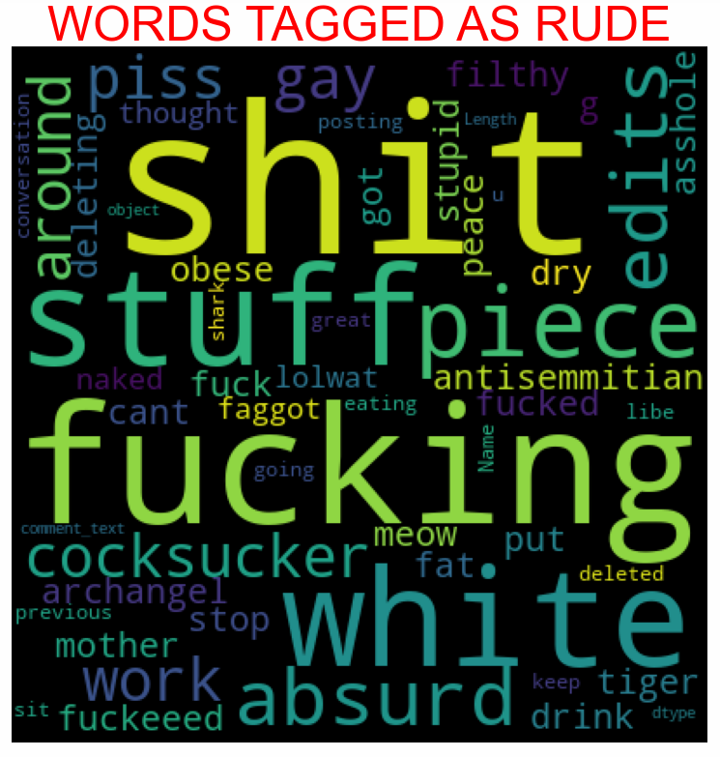
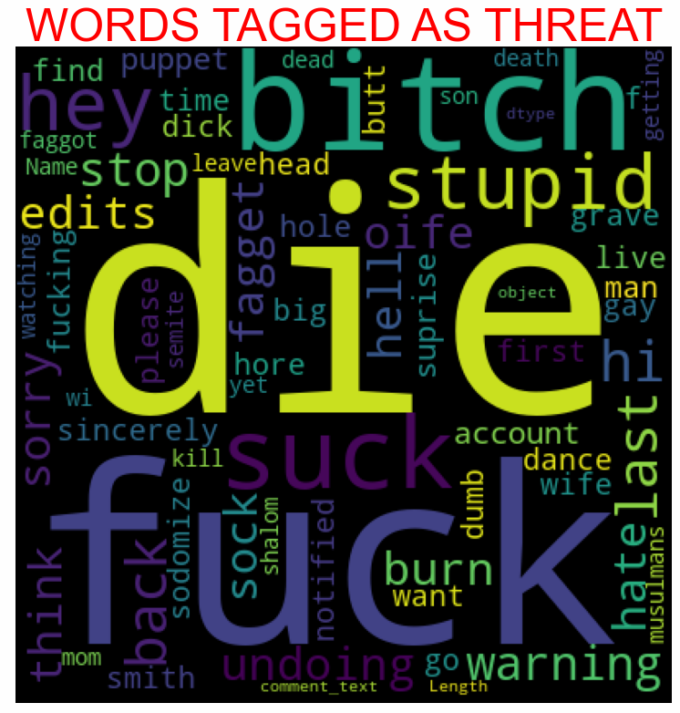

Slide 20
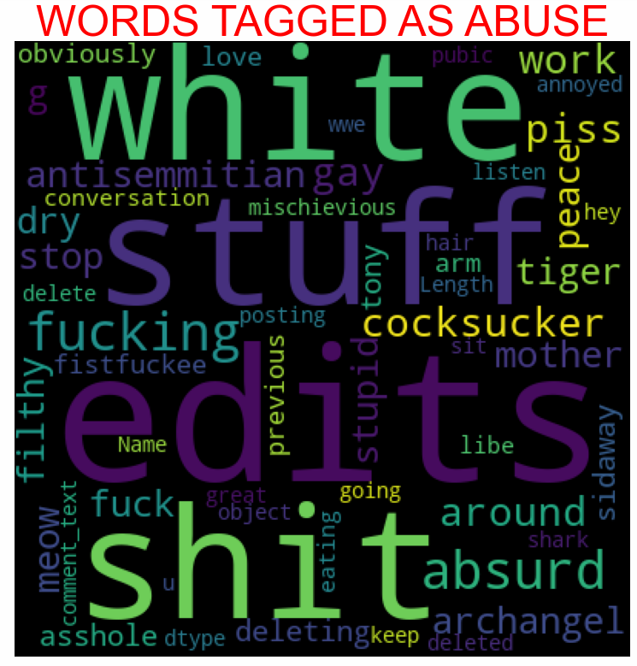
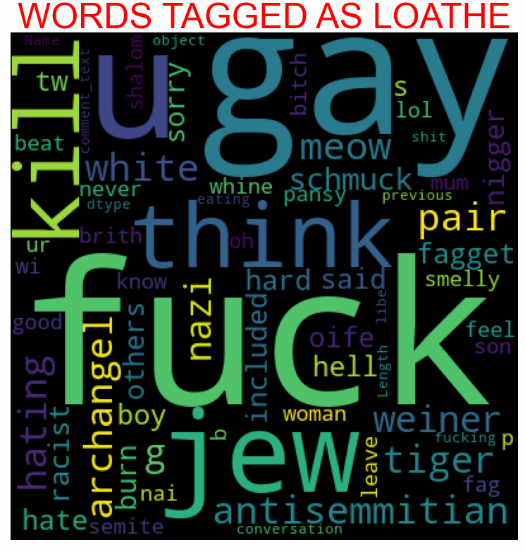

Slide 21
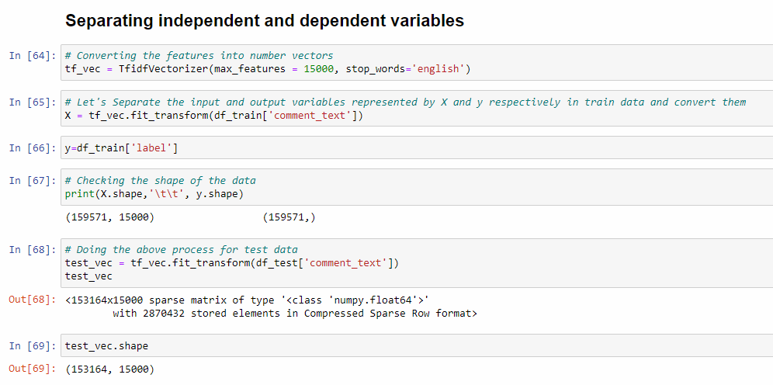
MODEL/S DEVELOPMENT AND EVALUATION

Slide 22
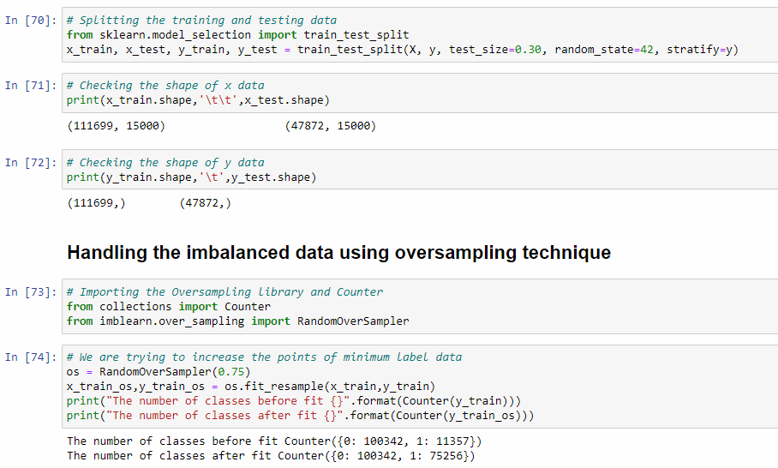
Splitting training and testing data, along with handling imbalanced dataset using RandomOverSampler

Slide 23
Splitting the data
We split our dataset into two parts training and testing, with 70% data of training and 30% of testing. We use train test split method.
70% of the observation as training set. x_train
The associated target for each observation in x_train , y_train
30% of the observation as test. x_test
The target associated with the test set. y_test
We found best score on random_state = 42

Slide 24
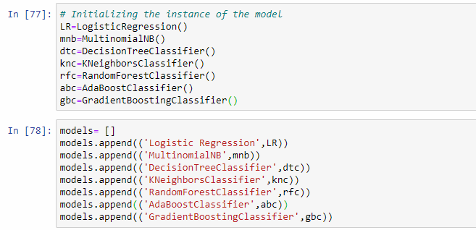
Building Machine Learning Algorithms

Slide 25
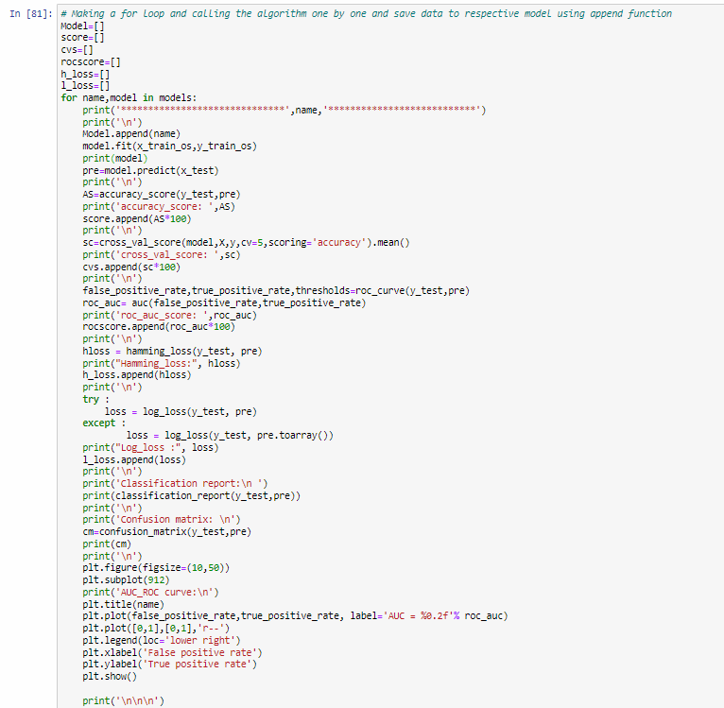
Evaluation of ML Models
As you can observe, I made a for loop and called all the algorithms one by one and appending their result to models.
Let me show the output so that we can glance the result in more appropriate way.

Slide 26
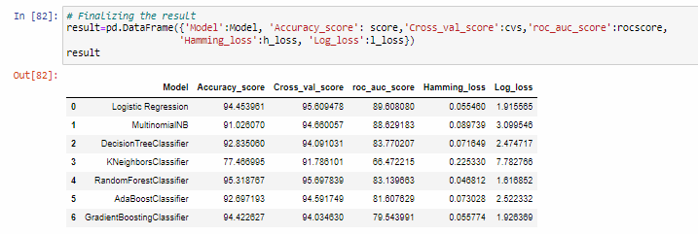
Result of ML Models
We saved result of ML Models in DataFrame.
From the above algorithms, we can say that the RandomForestClassifier is working well by giving an accuracy of 95.31% and cross validation score of 95.69%. Now we will perform Hyperparameter Tuning to improve accuracy of our model (i.e, RandomForestClassifier)

Slide 27
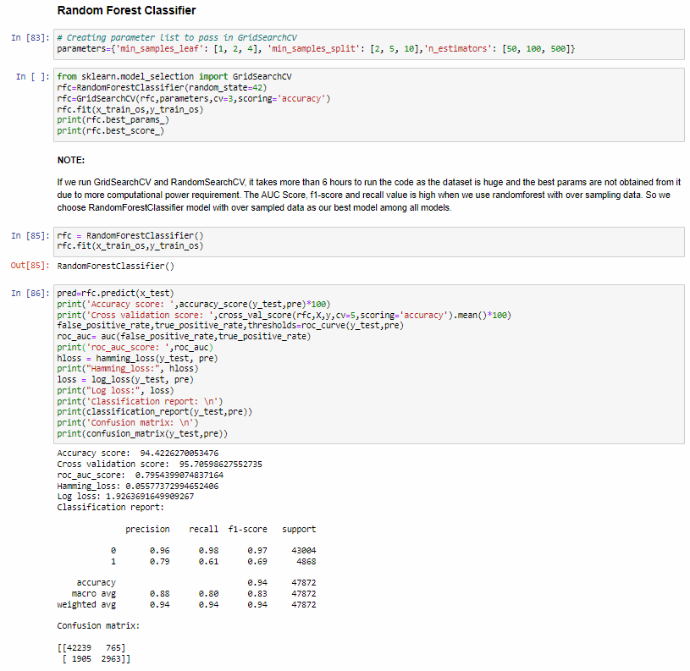
Hyperparameter Tuning

Slide 28
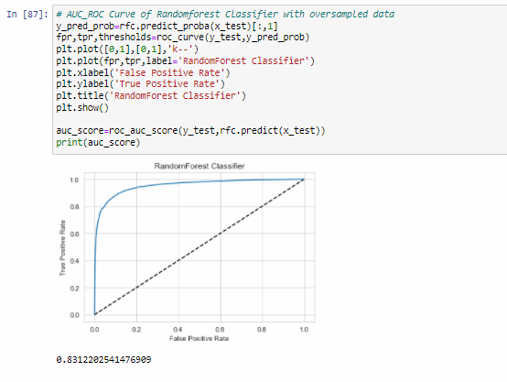

Slide 29
Conclusion
After the completion of this project, we got an insight of how to preprocess the data, analysing the data and building a model.
First, we imported both training and testing data, which had nearly 150000+ records.
We did all the required pre-processing steps like checking null values, datatypes check, dropping unnecessary columns, etc.
We used the training data for doing Exploratory Data Analysis using various plots and recorded the observations.
While observing the results, we found that the dataset was in highly imbalanced side and we need to handle it, in order to avoid overfitting problem.
Using NLP, we pre-processed the comment text and did other steps.
As the problem was a multi-class classifier, we took a new feature known as label and combined the comment_labels output together using sum() and then stored in that feature. For a binary classification problem, we scaled the data accordingly.
After applying Tf-idf Vectoriser, we used an oversampling technique called RandomOverSampler for handling the imbalanced data. There, we took 75% of the high points data and sampled it to the low points data so that both weights could be balanced equally and we could get proper result.

Slide 30
Then, we split the data using train_test_split and then we started the model building process by running as many algorithms in a for loop, with difference metrics like cross_val_score, confusion matrix, auc_score, log loss, hamming loss, etc.
We found that RandomForestClassifier was performing well. The next step was to perform hyperparameter tuning technique to these models for finding out the best parameters and trying to improve our scores.
The major problem with this dataset occurred in this step. It took me nearly 7 hrs to run the code for finding out the best parameters itself as the dataset is large and more computational power was required. Even though we found the best algorithms, it took me 7 hrs to get the results.
Therefore, without hyperparameter tuning, we finalized RandomForest as the best performing algorithm by predicting the outputs, saving the model and storing the results in a csv file
Then, by using the model we got, another set of predictions were done by using the test data and the results were stored in a separate csv file.

Slide 31


